Slide 1
FLIGHT PRICE PREDICTION PROJECT
by
Puneet Jawa

Slide 2
Problem Statement
With airfares fluctuating frequently, knowing when to buy and when to wait for a better deal to come along is tricky.
The fluctuation in prices is frequent and one has limited time to book the cheapest ticket as the prices keep varying due to constant manipulation by Airline companies.
Therefore, it is necessary to work on a predictive model based on deterministic and aggregate feature data that would predict with good accuracy the most optimal Air fare for a particular destination, route and schedule

Slide 3
Exploratory Data Analysis:
Visualizations
Barplots,Distplots,Boxplots,Countplots,lineplots were used to visualise the data of all the columns and their relationships with Target variable.

Slide 4
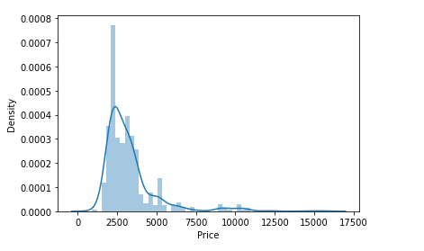
EDA:
Univariate Analysis
From the graph above it is observed that the Price data forms a continuous distribution with mean of 3280.675 and tails of from 5000 mark and the distribution is skewed.

Slide 5
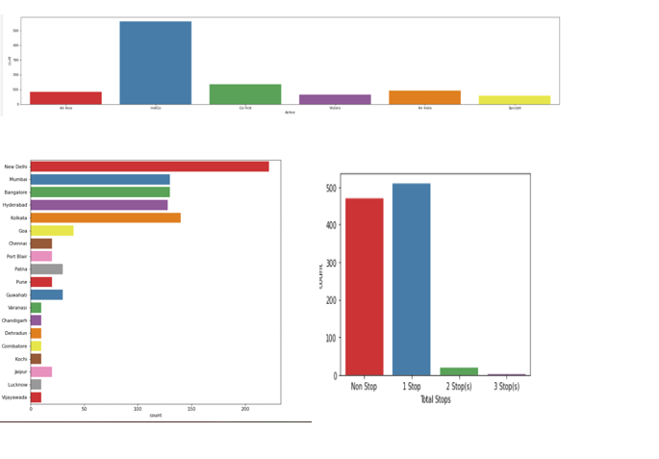
EDA Continues…..

Slide 6
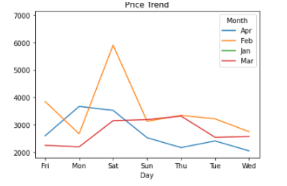
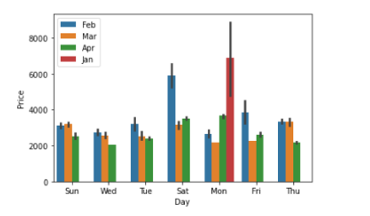
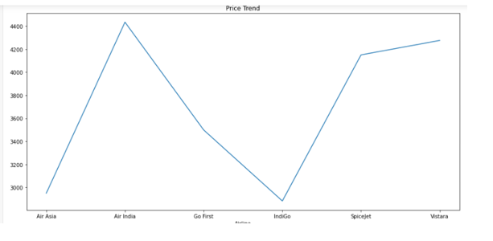
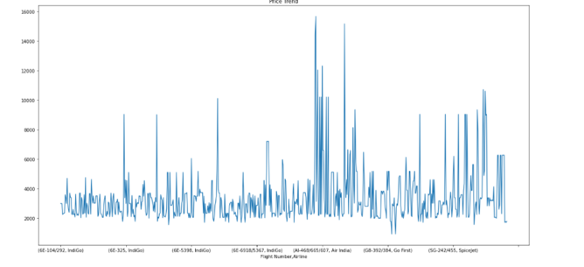
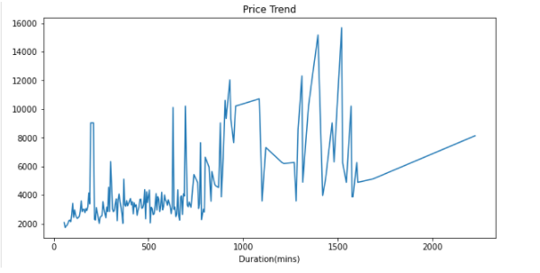
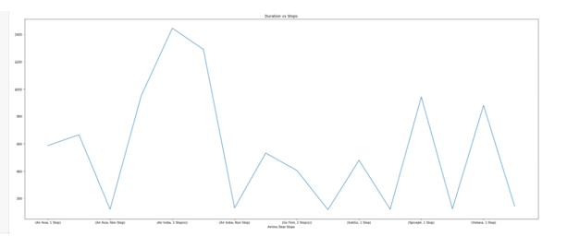
Bivariate Analysis
EDA Cont…..

Slide 7
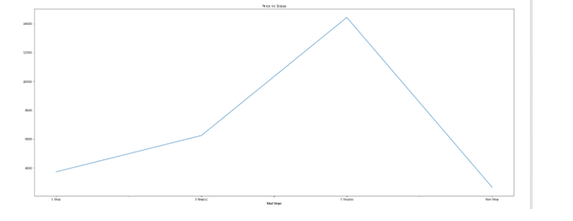
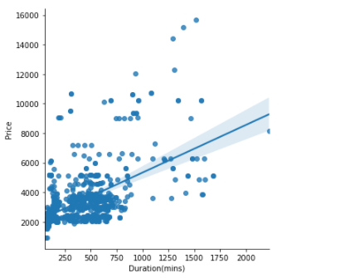
Bivariate Analysis Cont….
EDA Cont…..

Slide 8
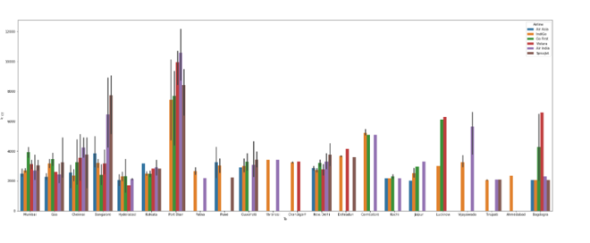
Multivariate Analysis
EDA Cont…..

Slide 9
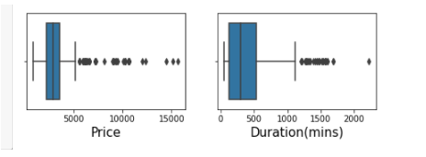
Outliers
Outliers were Removed using Z score method which resulted in a total data loss of 2.80%, which is within acceptable range.

Slide 10
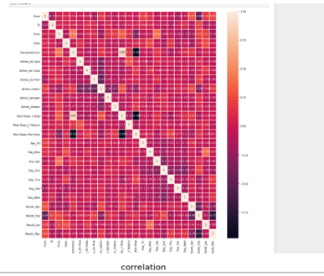
Correlation

Slide 11
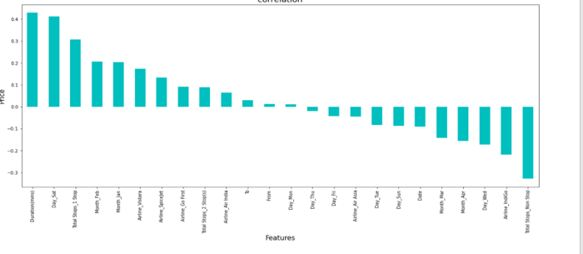
Correlation Cont….
It is observed that Month_Feb Duration(mins), Airline_Vistara,Total Stops_2-stop and From have the highest positive correlation with Price, while Date,Total Stops_non-stop,Month_Apr,Airline_IndiGo have the highest negative correlation with Price

Slide 12
Model Performance
The model algorithms used are :
Ridge
DecisionTreeRegressor
XGBRegressor
RandomForestRegressor:
Support Vector Regressor:

Slide 13
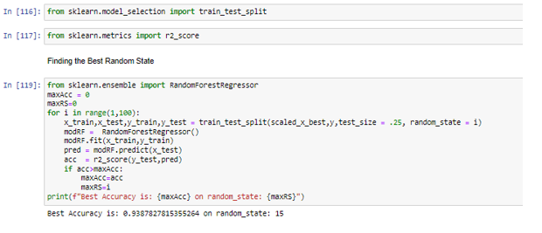
Model Building
Regression Model Building
Best random state was determined to be 15

Slide 14
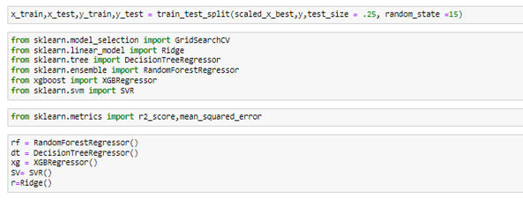
Model Building Cont…

Slide 15

Training the Model
Analyzing Accuracy of The Models
Mean Squared Error and Root Mean Squared Error metrics were used to evaluate the Model performance. The advantage of MSE and RMSE being that it is easier to compute the gradient.
As, we take square of the error, the effect of larger errors become more pronounced than smaller error, hence the model can now focus more on the larger errors.

Slide 16
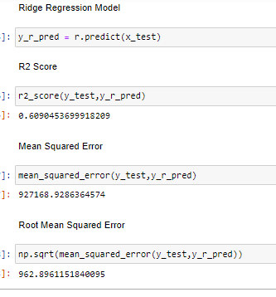
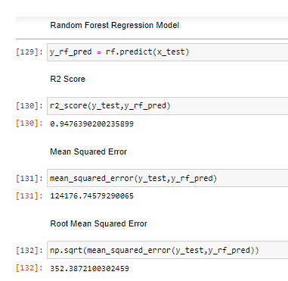
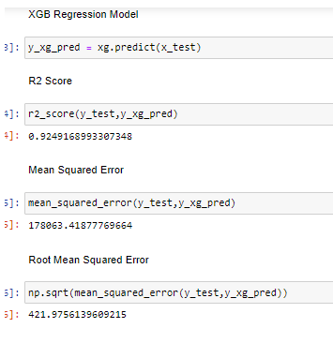
Analyzing Accuracy of The Models Cont…

Slide 17
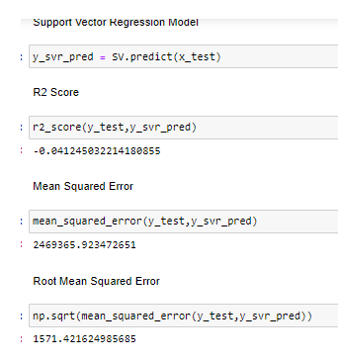
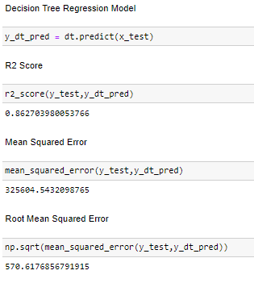
Analyzing Accuracy of The Models Cont…

Slide 18
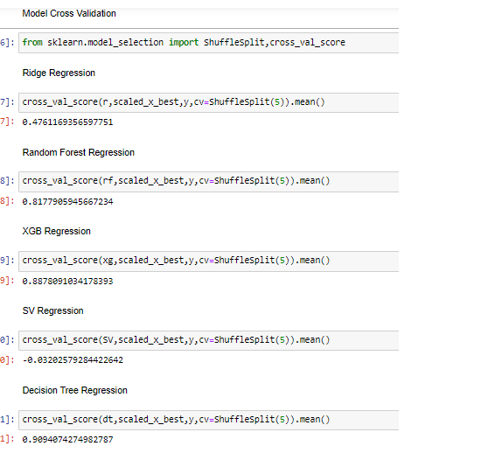
Cross Validation Score

Slide 19
Conclusion
In summary, Based on the visualizations of the feature-column relationships, it is determined that, Features like Source,month,Duration,Total Stops,Airline,Date are some of the most important features to predict the label values. Random Forest Regressor Performed the best out of all the models that were tested. It also worked well with the outlier handling.
Based on the in-depth analysis of the Flight Price Prediction Project, The Exploratory analysis of the datasets, and the analysis of the Outputs of the models the following observations are made:
Air Fare attributes like Date,Month,Duration,Total Stops etc play a big role in influencing the used Flight price.
Airline Brand also has a very important role in determining the used Flight Ticket price.

Slide 20
Conclusion Cont..
Various plots like Barplots,Countplots and Lineplots helped in visualising the Feature-label relationships which corroborated the importance of Air Fare features and attributes for estimating Flight Ticket Prices.
Random Forest Regressor, which uses averaging to improve the predictive accuracy and controls over-fitting. performed well despite having to work on small dataset and produced good predictions that can be understood easily.

